Slide 1
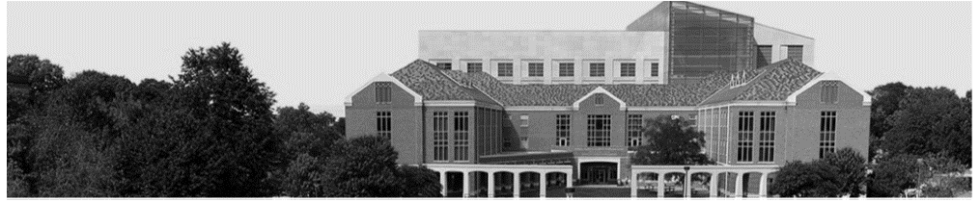

VET: Autonomous Vehicular Credential Verification using Trajectory and Motion Vectors
Ebuka Oguchi and Nirnimesh Ghose
School of Computing
19th EAI INTERNATIONAL CONFERENCE ON SECURITY AND PRIVACY IN COMMUNICATION NETWORKS
OCTOBER 19 – 21, 2023

Slide 2
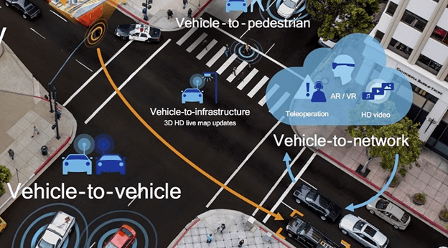
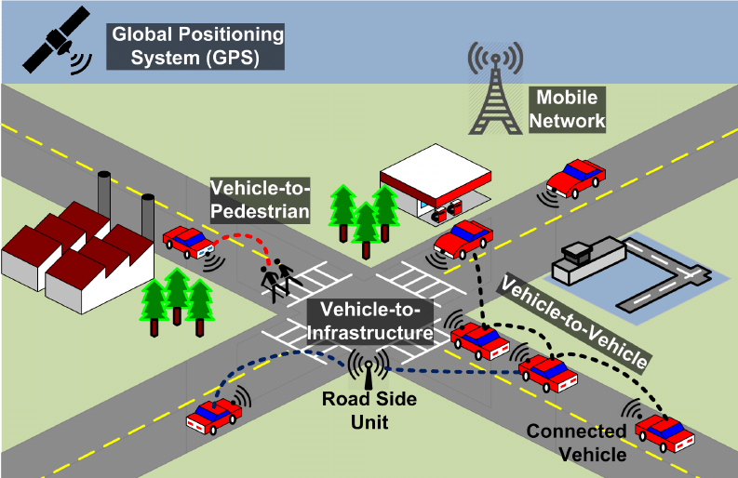
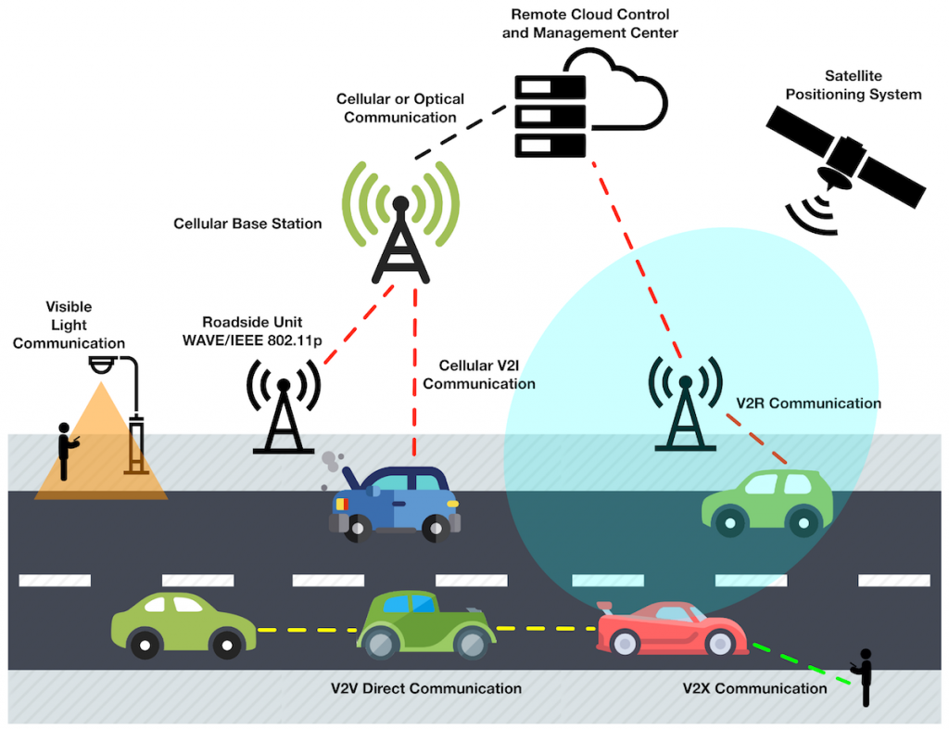
Background
Connected Autonomous Vehicles (CAV) and Unmanned Aerial Vehicles (UAV):
Avoid Collisions and Hazards ahead
Platooning
Safe and efficient traffic control
Geofencing and Midair colision avoidance, etc.

Slide 3
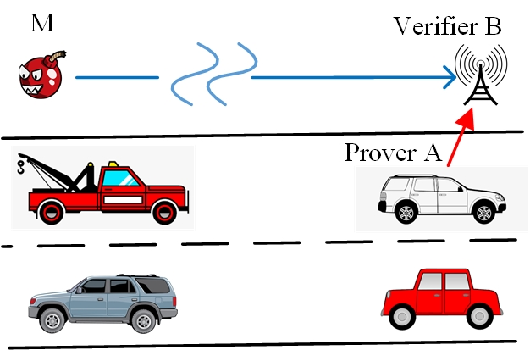
Motivation
Traditional Crypto-based veracity verification allows adversaries to inject malicious data by just being in communication range.
Allowing an advanced adversary with powerful antennas can remotely inject data.
Question: How can we securely verify the truthfulness the location and velocity claims
of a vehicle to prevent such attacks?

Slide 4
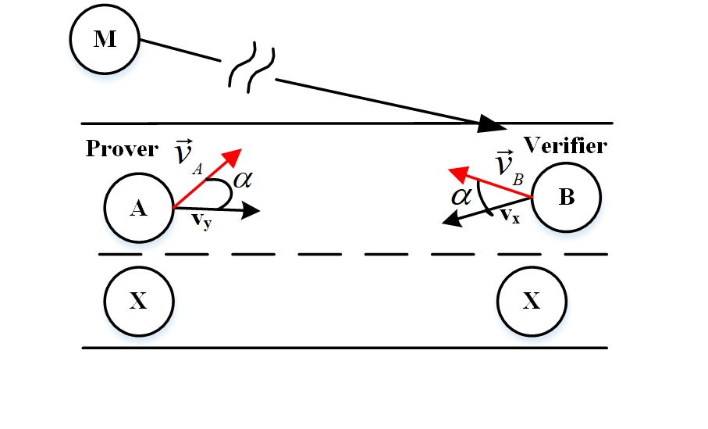
Objectives
A
Prover
B
Verifier
X
Verifier x
M
Adversary
To develop a framework for credential verification using Trajectory and Motion Vectors (TMVs) for autonomous Vehicles.
To utilize a location and motion-based authentication strategy to prevent message injection attack
To perform verification by comparing the claimed TMVs with randomly estimated TMVs
To build a reliable verification solution that places no assumption on the wireless environment
e.g, number of reflectors, center frequency etc

Slide 5
System Model
The Legitimate Prover A
A uses omnidirectional antenna
Has valid credentials (PKI or Symmetric key)
The Verifier B
Other truthful verifier X
Perform verification independently
Verifiers do not require mutual trust.

Slide 6
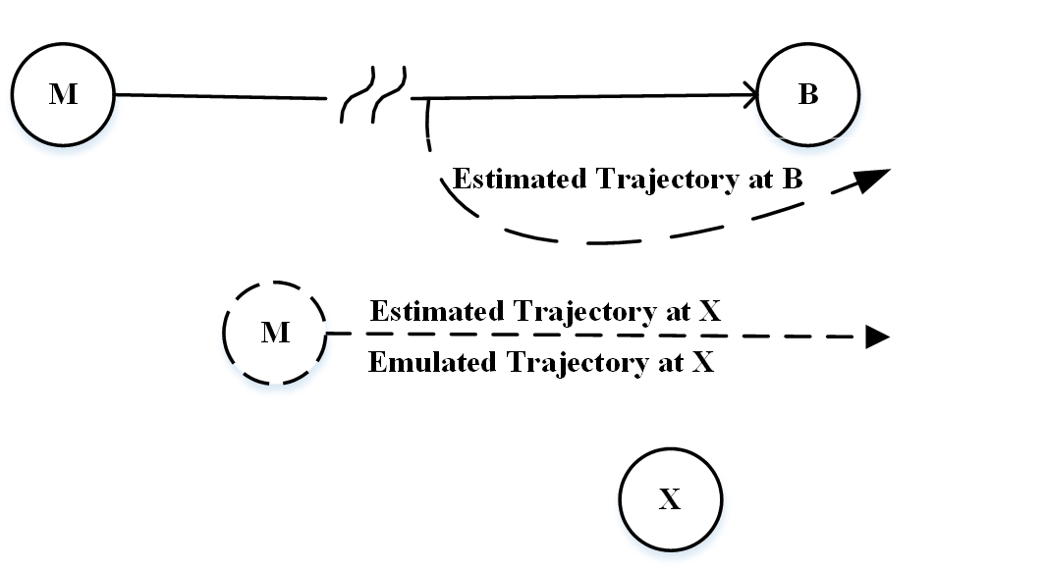
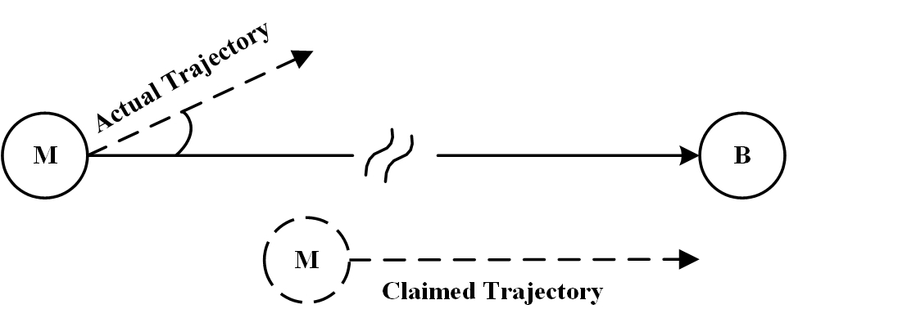
Threat Model
Remote Attacker
Remote Advanced Attacker
Has valid credentials
Can additionally intentionally modifying PHY-layer data.
Has valid credentials
Within the communication range of B
Attempting to Inject messages without modifying PHY-layer data

Slide 7
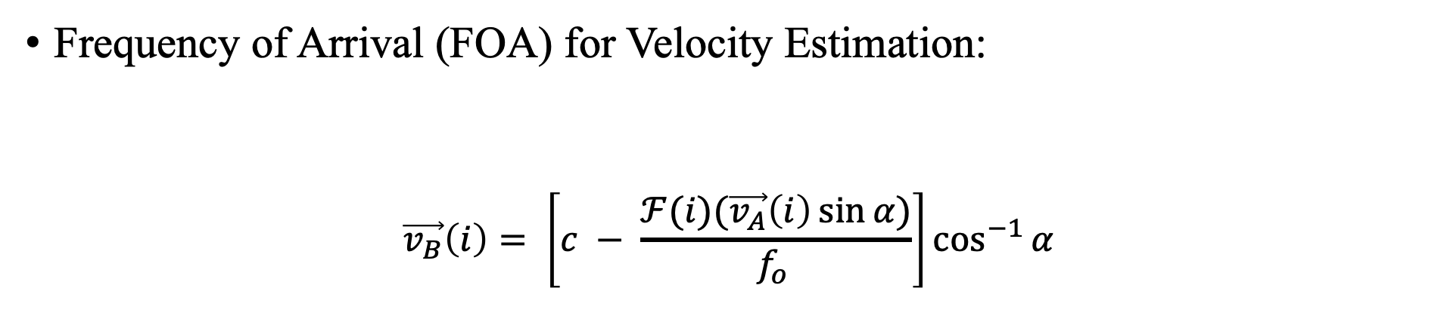
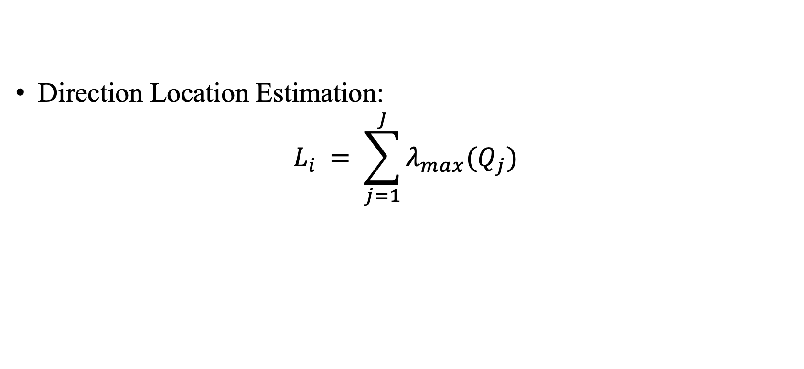
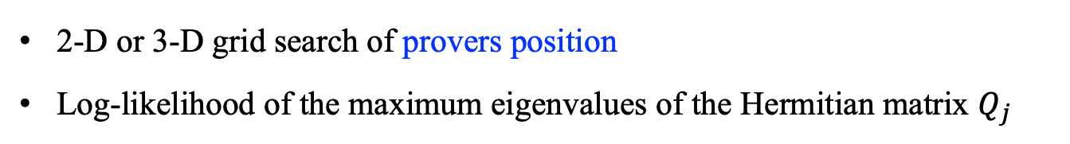
Preliminaries
Frequency of Arrival (FOA) for Velocity Estimation:
$$\vec{v_{B}}\left(i\right)= \left[c − \frac{ℱ(i)(\vec{v_{A}}\left(i\right)\sin{α})}{f_{o }}\right]\cos^{−1}{α}$$
Direction Location Estimation:
$$L_{i }= \sum_{j=1}^{J}{λ_{max}(Q_{j})}$$
2-D or 3-D grid search of provers position
Log-likelihood of the maximum eigenvalues of the Hermitian matrix $Q_{j}$

Slide 8

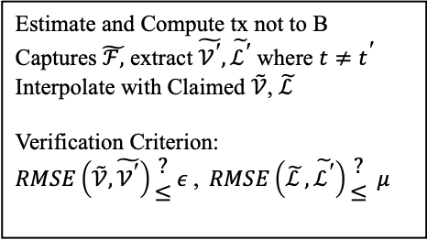
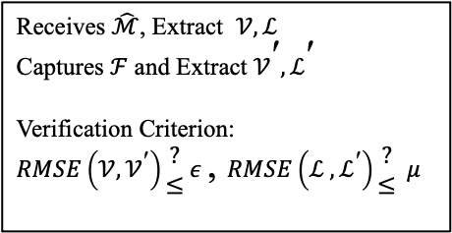
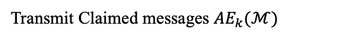
VET: Credential Verification using Trajectory and Motion Vectors
A
B
X
Initialization
$${AE}_{K}(RTA)$$
Grants Limited Access
Receives $\hat{ℳ}$, Extract $𝒱,ℒ$
Captures $ℱ$ and Extract $𝒱^{\text{′}},ℒ^{\text{′}}$
Verification Criterion: $RMSE\left(𝒱,𝒱^{\text{′}}\right)\begin{matrix}? \\ ≤\end{matrix} ε$,$RMSE\left(ℒ ,ℒ^{\text{′}}\right)\begin{matrix}? \\ ≤\end{matrix} μ$
Transmit Claimed messages ${AE}_{k}(ℳ)$
Partial access Else Fail
Compute and transmit TMVs to X not to B
Sniffing packets
Estimate and Compute tx not to B
Captures $\tilde{ℱ,}$ extract $\tilde{𝒱^{\text{′}}},\tilde{ℒ^{\text{′}}}$ where $t≠t^{\text{′}}$
Interpolate with Claimed $\tilde{𝒱}$, $\tilde{ℒ }$
Verification Criterion:
$RMSE\left(\tilde{𝒱},\tilde{𝒱^{\text{′}}}\right)\begin{matrix}? \\ ≤\end{matrix} ε$,$RMSE\left(\tilde{ℒ },\tilde{ℒ^{\text{′}}}\right)\begin{matrix}? \\ ≤\end{matrix} μ$
Broadcast Decision
Grant Full access Else Fail

Slide 9
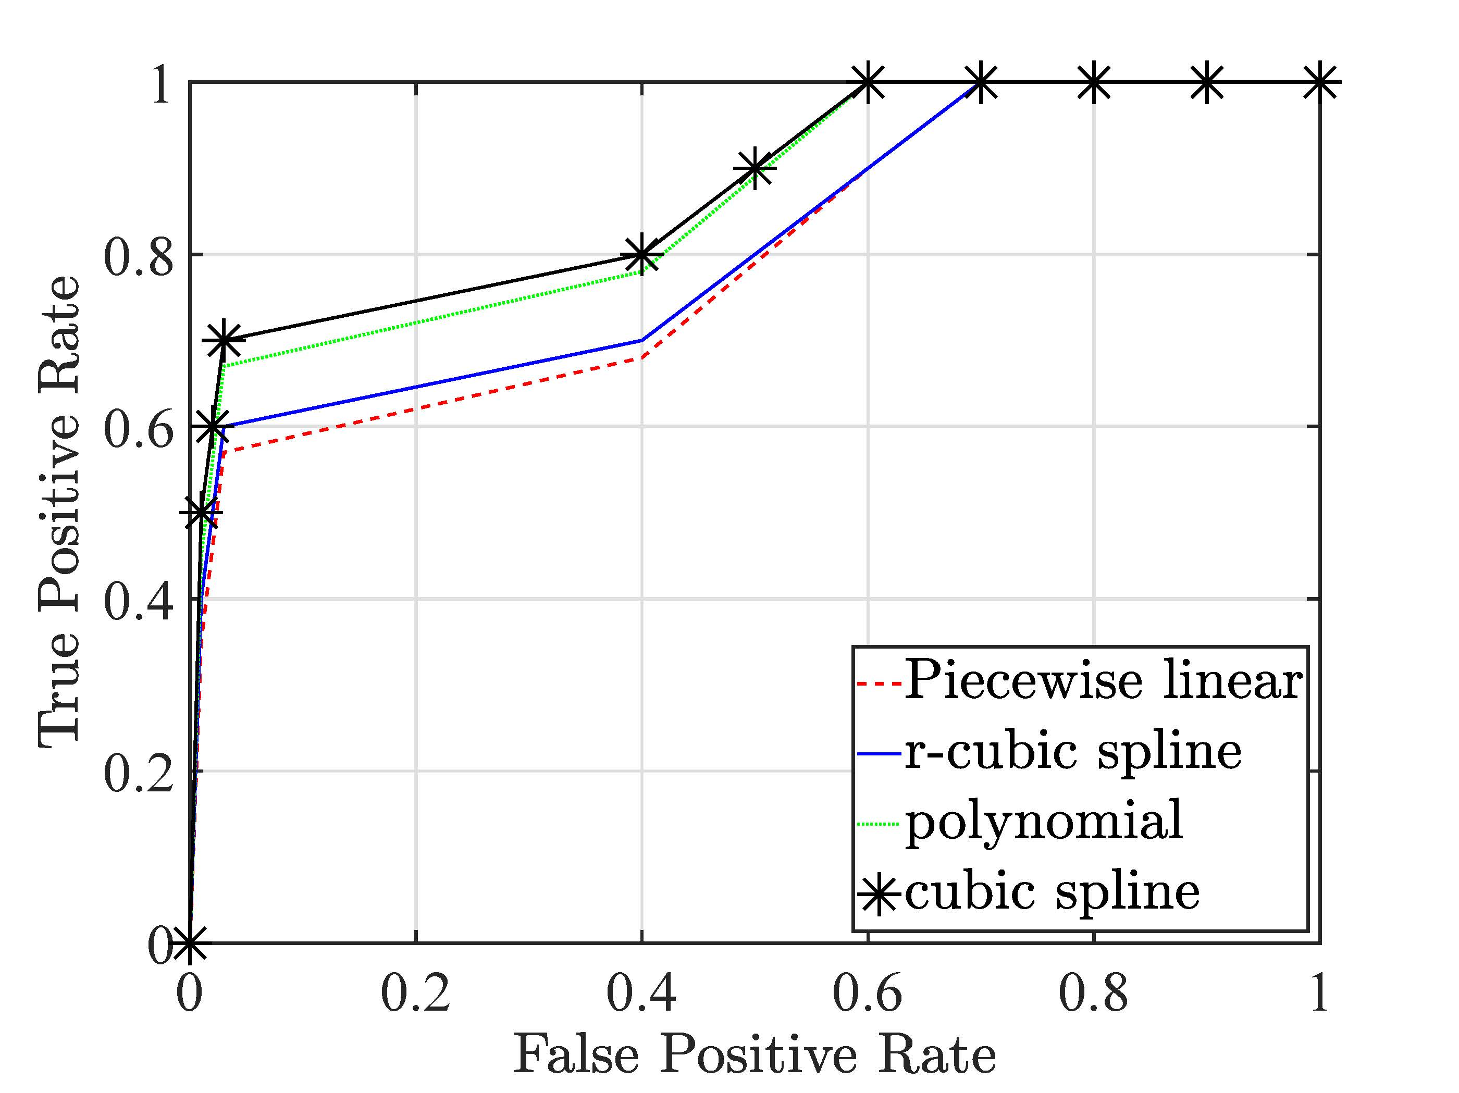
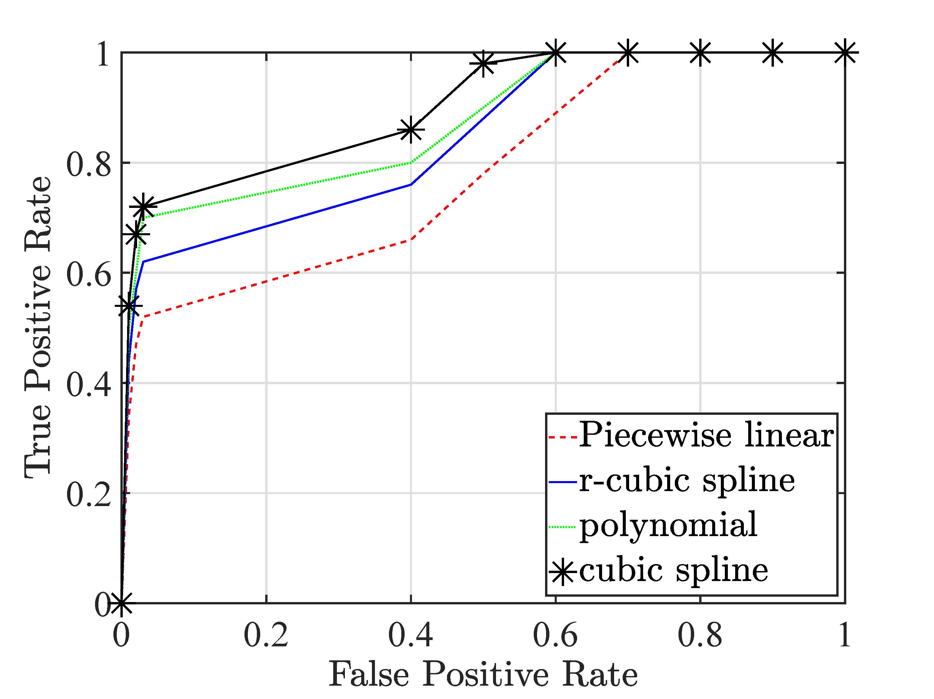
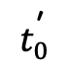
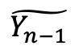
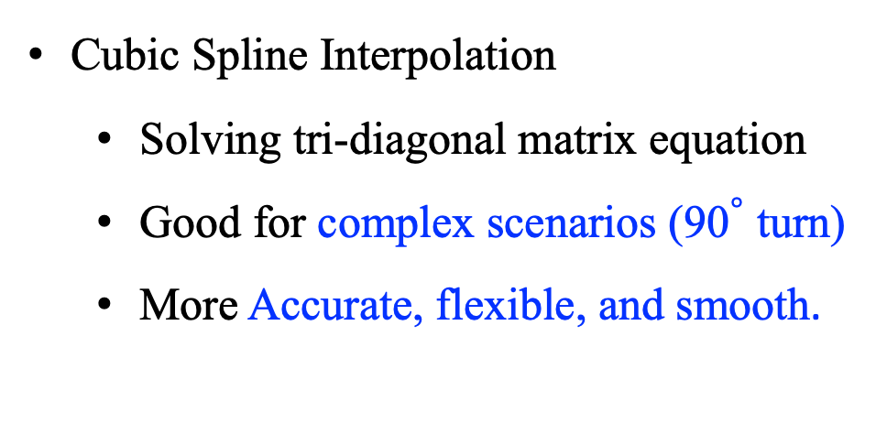
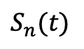
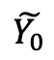
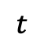
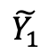
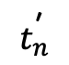
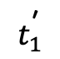
Interpolating TMVs
Cubic spline is better
$$S_{n}(t)$$
$$t$$
$$\tilde{Y_{0}}$$
$$t_{0}^{\text{′}}$$
$$\tilde{Y_{1}}$$
$$t_{1}^{\text{′}}$$
$$t_{n}^{\text{′}}$$
$$\tilde{Y_{n−1}}$$
Interpolation
Location ROC
Velocity ROC
Cubic Spline Interpolation
Solving tri-diagonal matrix equation
Good for complex scenarios (${\text{90}}^{°}$ turn)
More Accurate, flexible, and smooth.

Slide 10
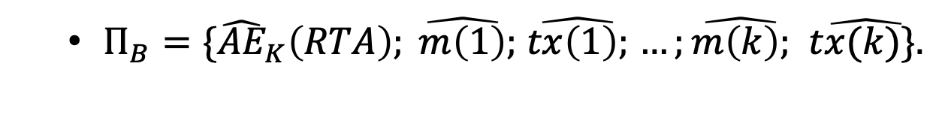
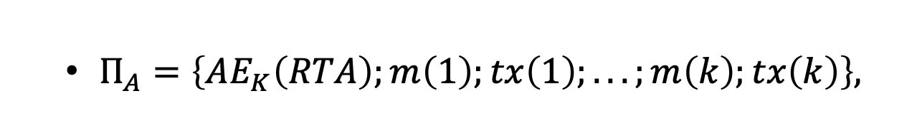
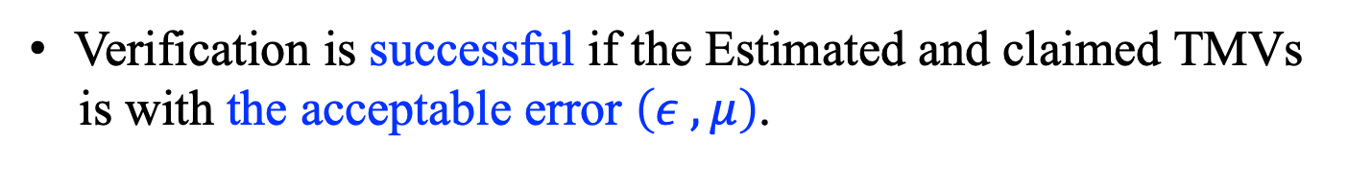
Formal Analysis of VET: Correctness Analysis
$Π_{A}=\left\{{AE}_{K}\left(RTA\right);m\left(1\right);tx\left(1\right);. . . ;m\left(k\right);tx\left(k\right)\right\},$
$Π_{B}=\{{\hat{AE}}_{K}\left(RTA\right); \hat{m\left(1\right)};$ $\hat{tx\left(1\right);}$ $…;\hat{m\left(k\right);}$ $\hat{tx(k)\}.}$
Verification is successful if the Estimated and claimed TMVs
is with the acceptable error $\left(ε , μ\right)$.

Slide 11
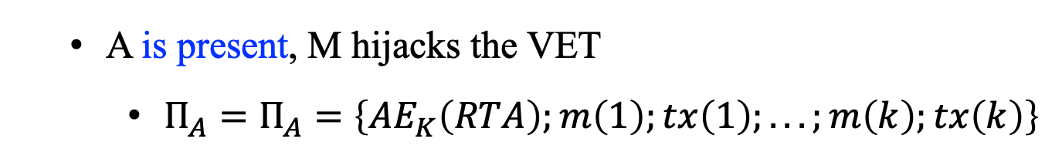
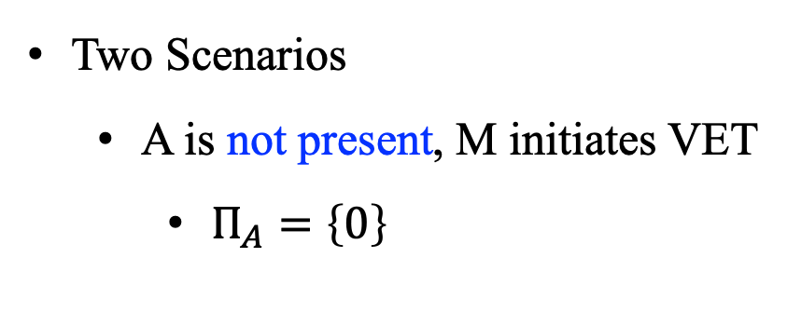
Formal Analysis of VET: Robustness Analysis
A Remote Attacker
$Π_{M}=\{{\hat{AE}}_{KM}\left(RTA\right); \hat{m_{M}\left(1\right)};$ $\hat{{tx}_{M}\left(1\right);}$ $…;\hat{m_{M}\left(k\right);}$ $\hat{{tx}_{M}(k)\},}$
$Π_{B}=\{{\hat{AE}}_{KM}\left(RTA\right); \hat{m_{M}\left(1\right)};$ $\hat{{tx}_{M}\left(1\right);}$ $…;\hat{m_{M}\left(k\right);}$ $\hat{{tx}_{M}(k)\}.}$
Two Scenarios
A is not present, M initiates VET
$Π_{A}=\left\{0\right\}$
A is present, M hijacks the VET
$Π_{A}=Π_{A}=\left\{{AE}_{K}\left(RTA\right);m\left(1\right);tx\left(1\right);. . . ;m\left(k\right);tx\left(k\right)\right\}$

Slide 12
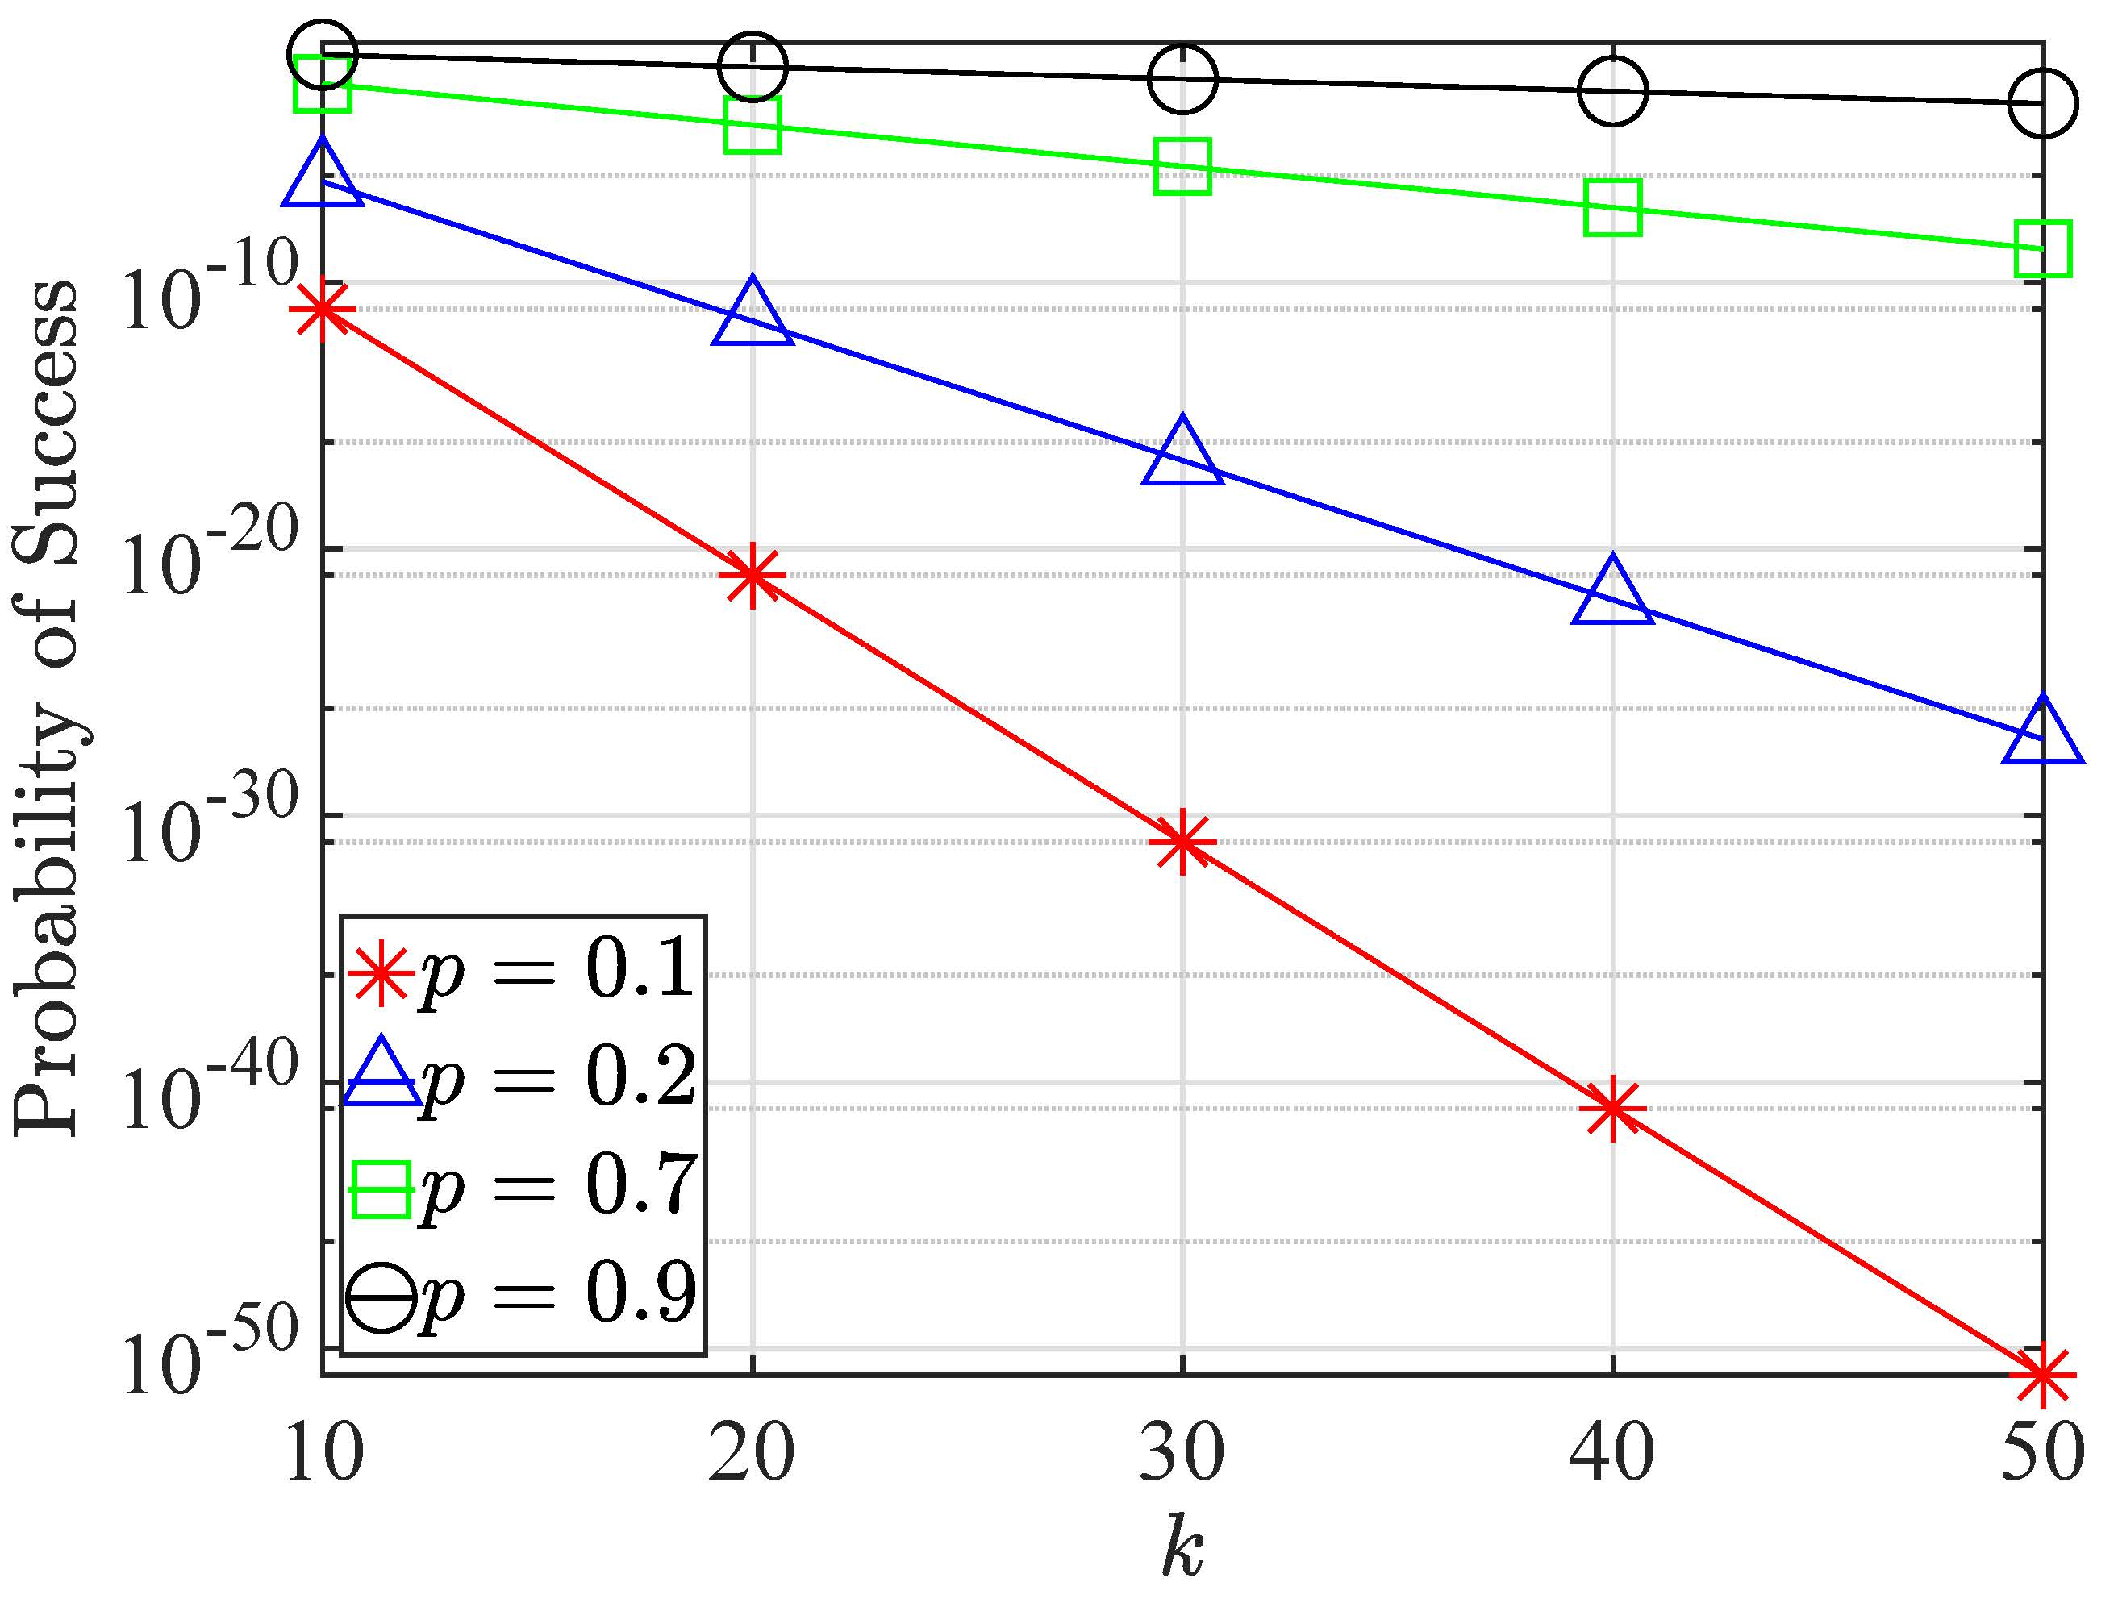
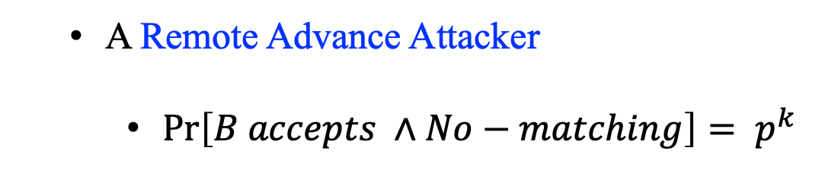
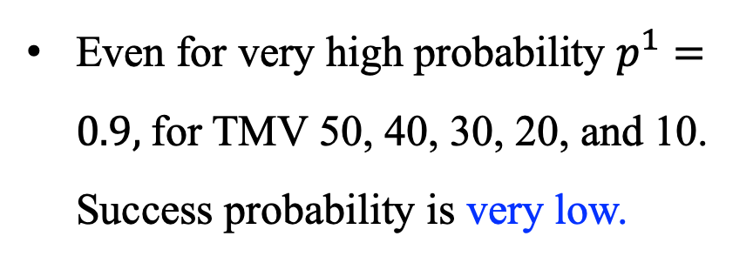
Security Analysis
Very low
A Remote Advance Attacker
$\operatorname{Pr}\left[B accepts ∧No−matching\right]= p^{k}$
Even for very high probability $p^{1}=0.9,$for TMV 50, 40, 30, 20, and 10. Success probability is very low.
Success Probability

Slide 13
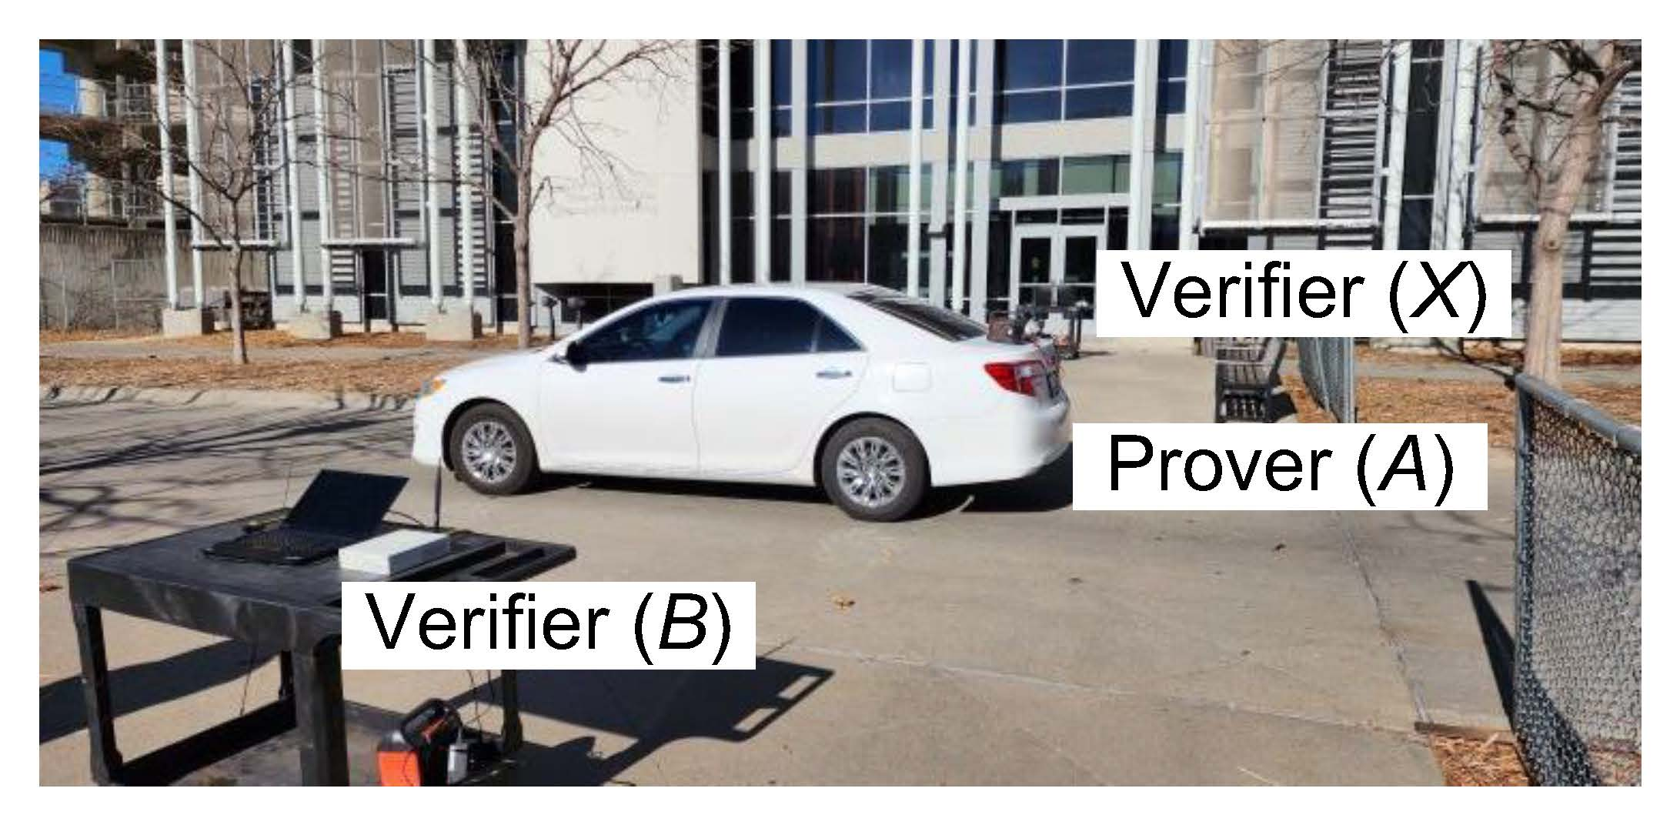
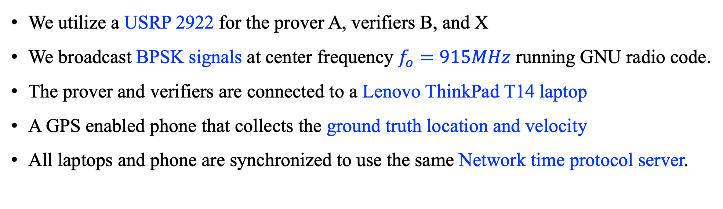
Experimental Setup
We utilize a USRP 2922 for the prover A, verifiers B, and X
We broadcast BPSK signals at center frequency $f_{o}=915MHz$ running GNU radio code.
The prover and verifiers are connected to a Lenovo ThinkPad T14 laptop
A GPS enabled phone that collects the ground truth location and velocity
All laptops and phone are synchronized to use the same Network time protocol server.

Slide 14
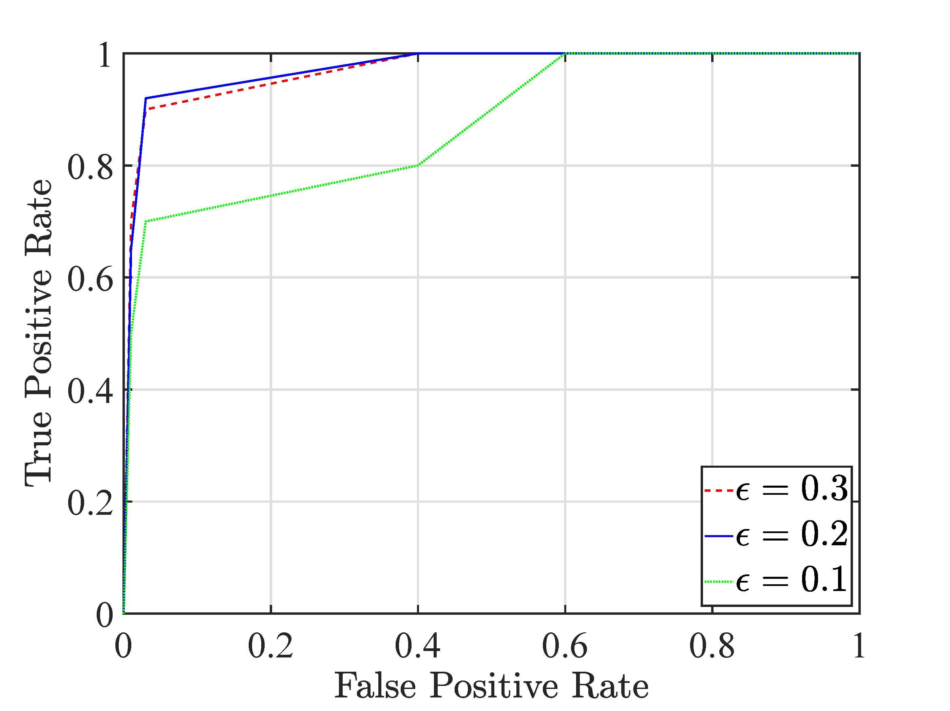
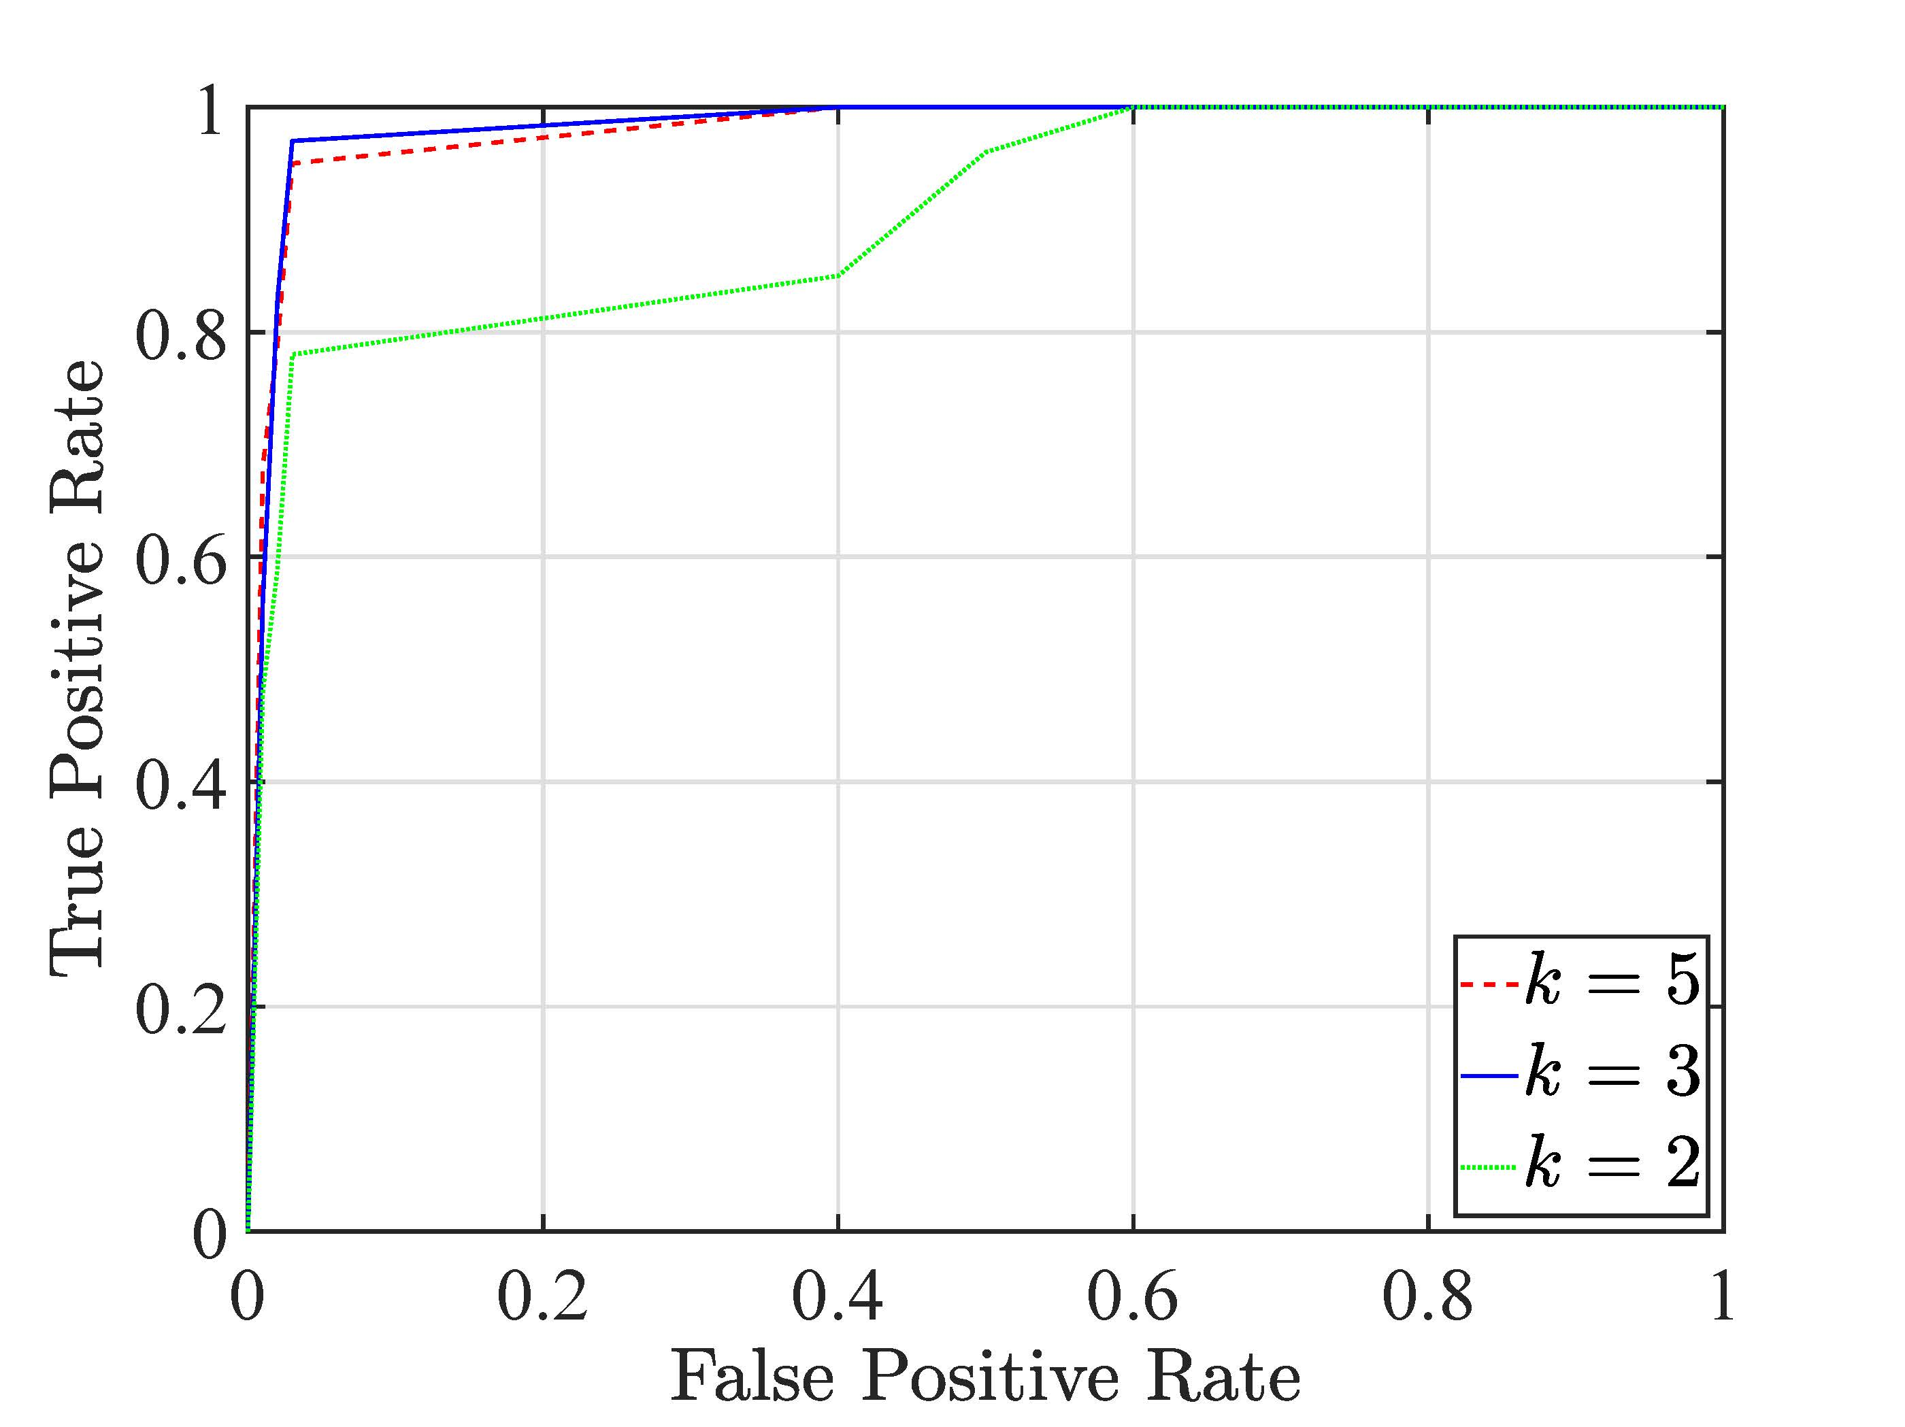

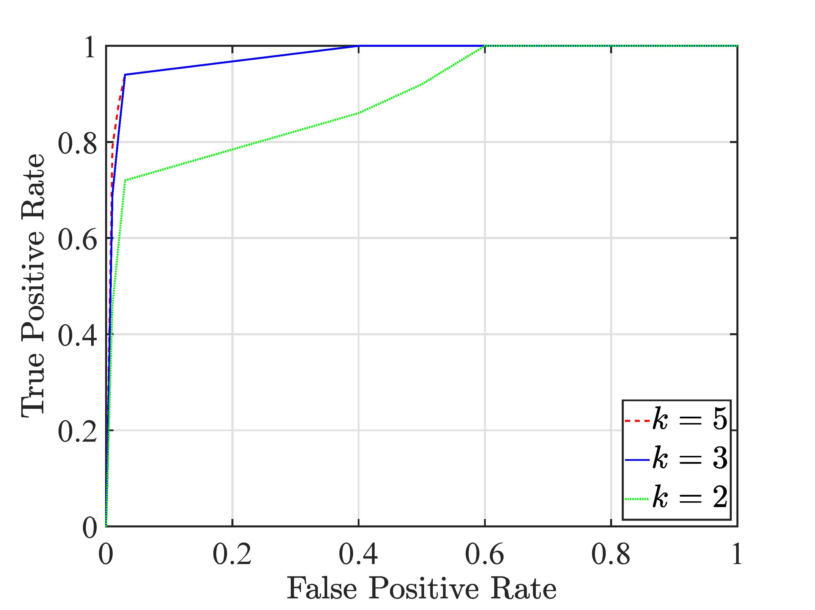
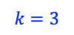
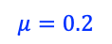
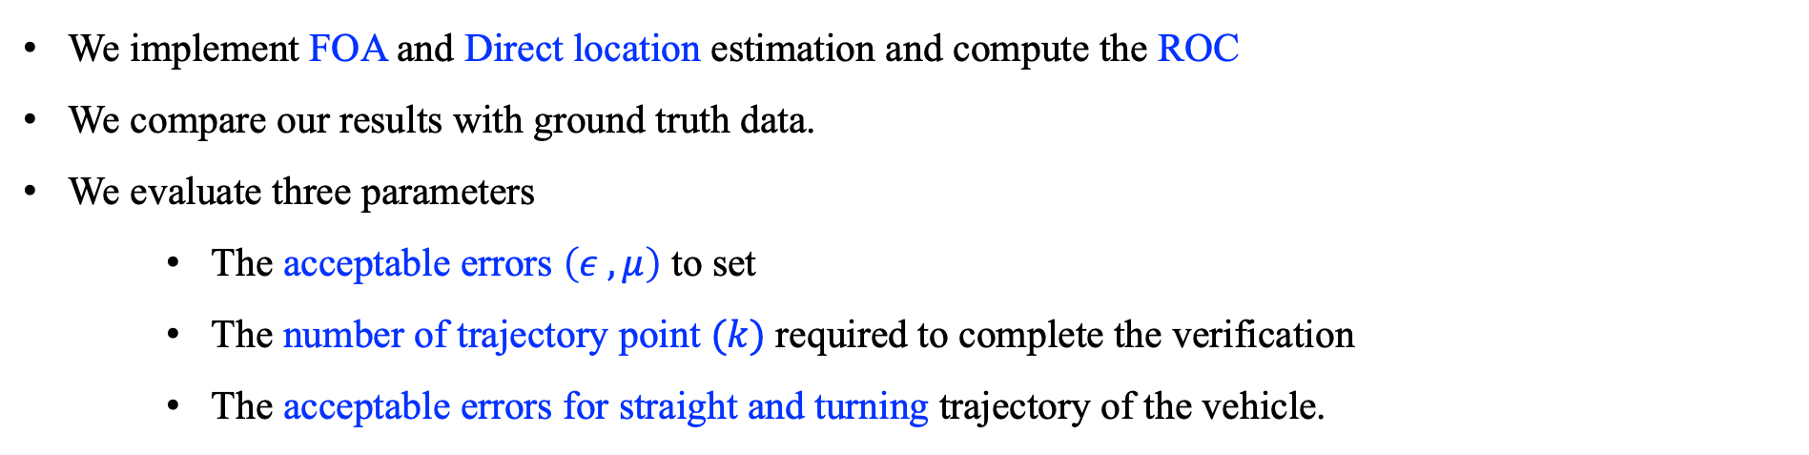
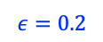
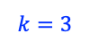
Experimental Evaluation: Correctness Analysis
$$ε=0.2$$
$$k=3$$
$$μ=0.2$$
$$k=3$$
ROC for Location
ROC for velocity
We implement FOA and Direct location estimation and compute the ROC
We compare our results with ground truth data.
We evaluate three parameters
The acceptable errors $\left(ε , μ\right)$ to set
The number of trajectory point $(k)$ required to complete the verification
The acceptable errors for straight and turning trajectory of the vehicle.

Slide 15
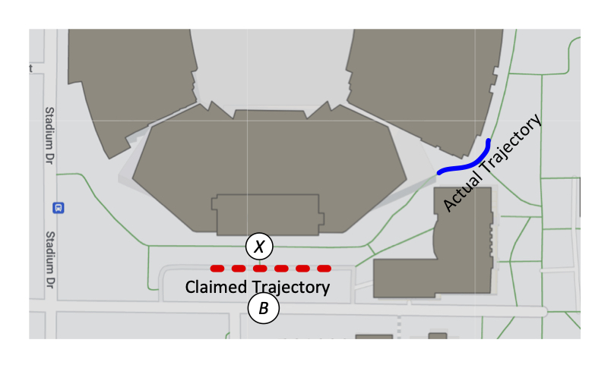
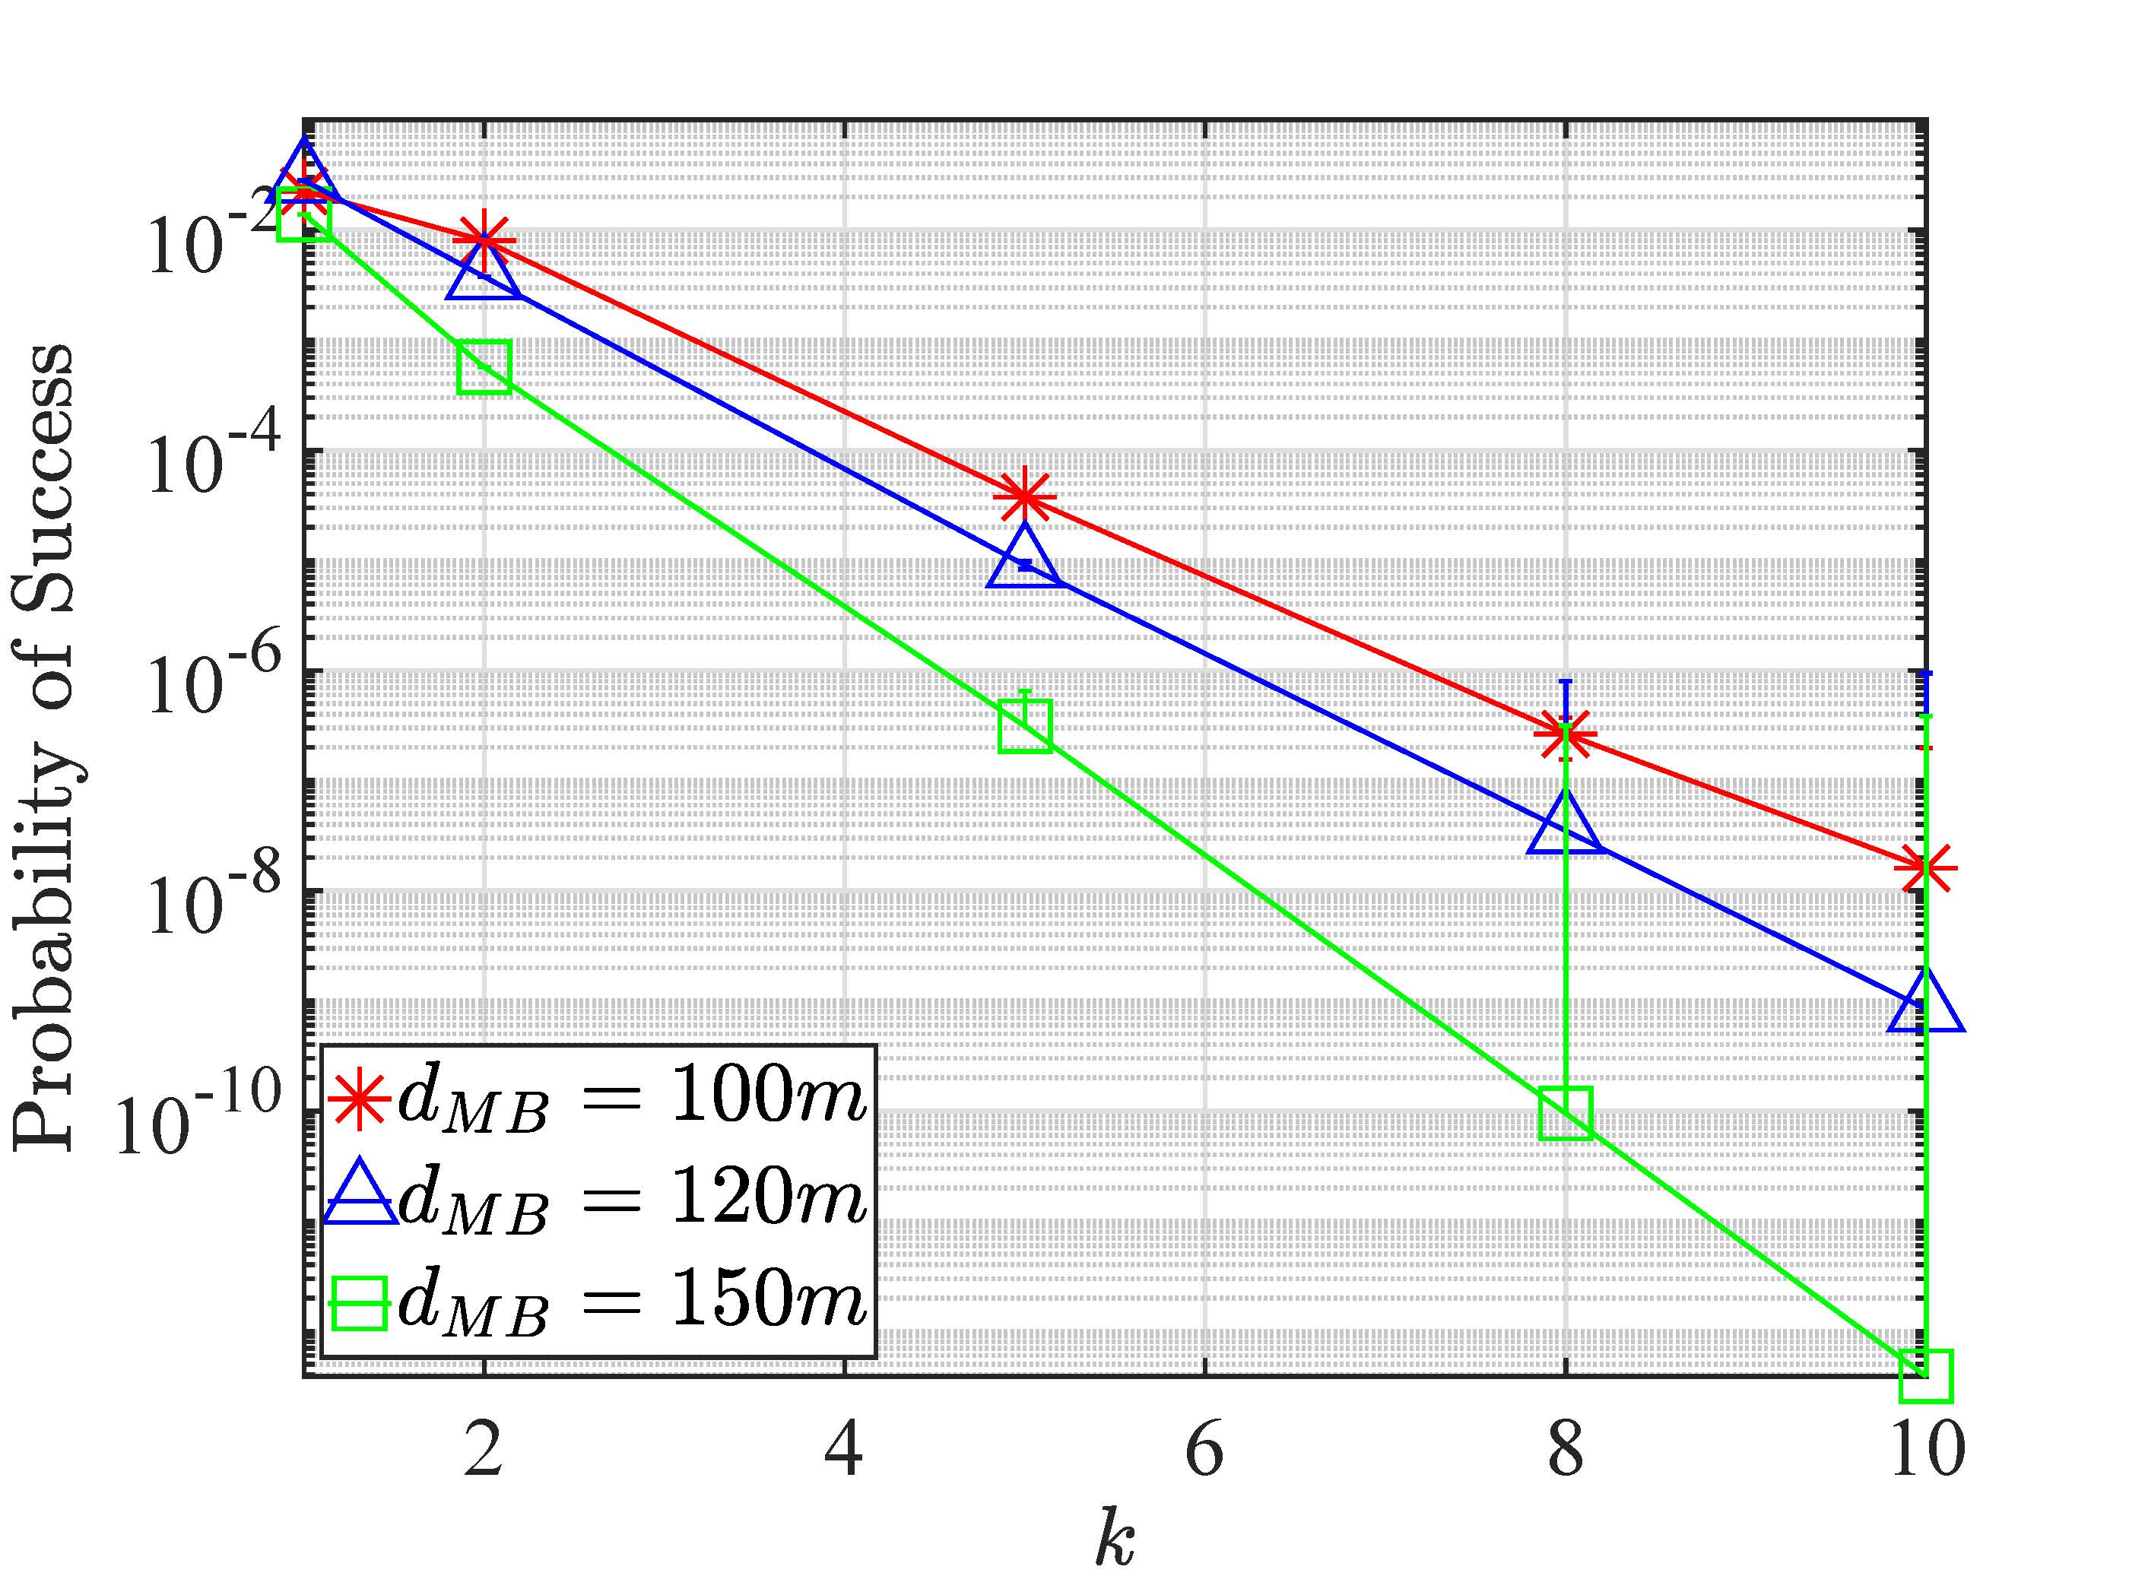
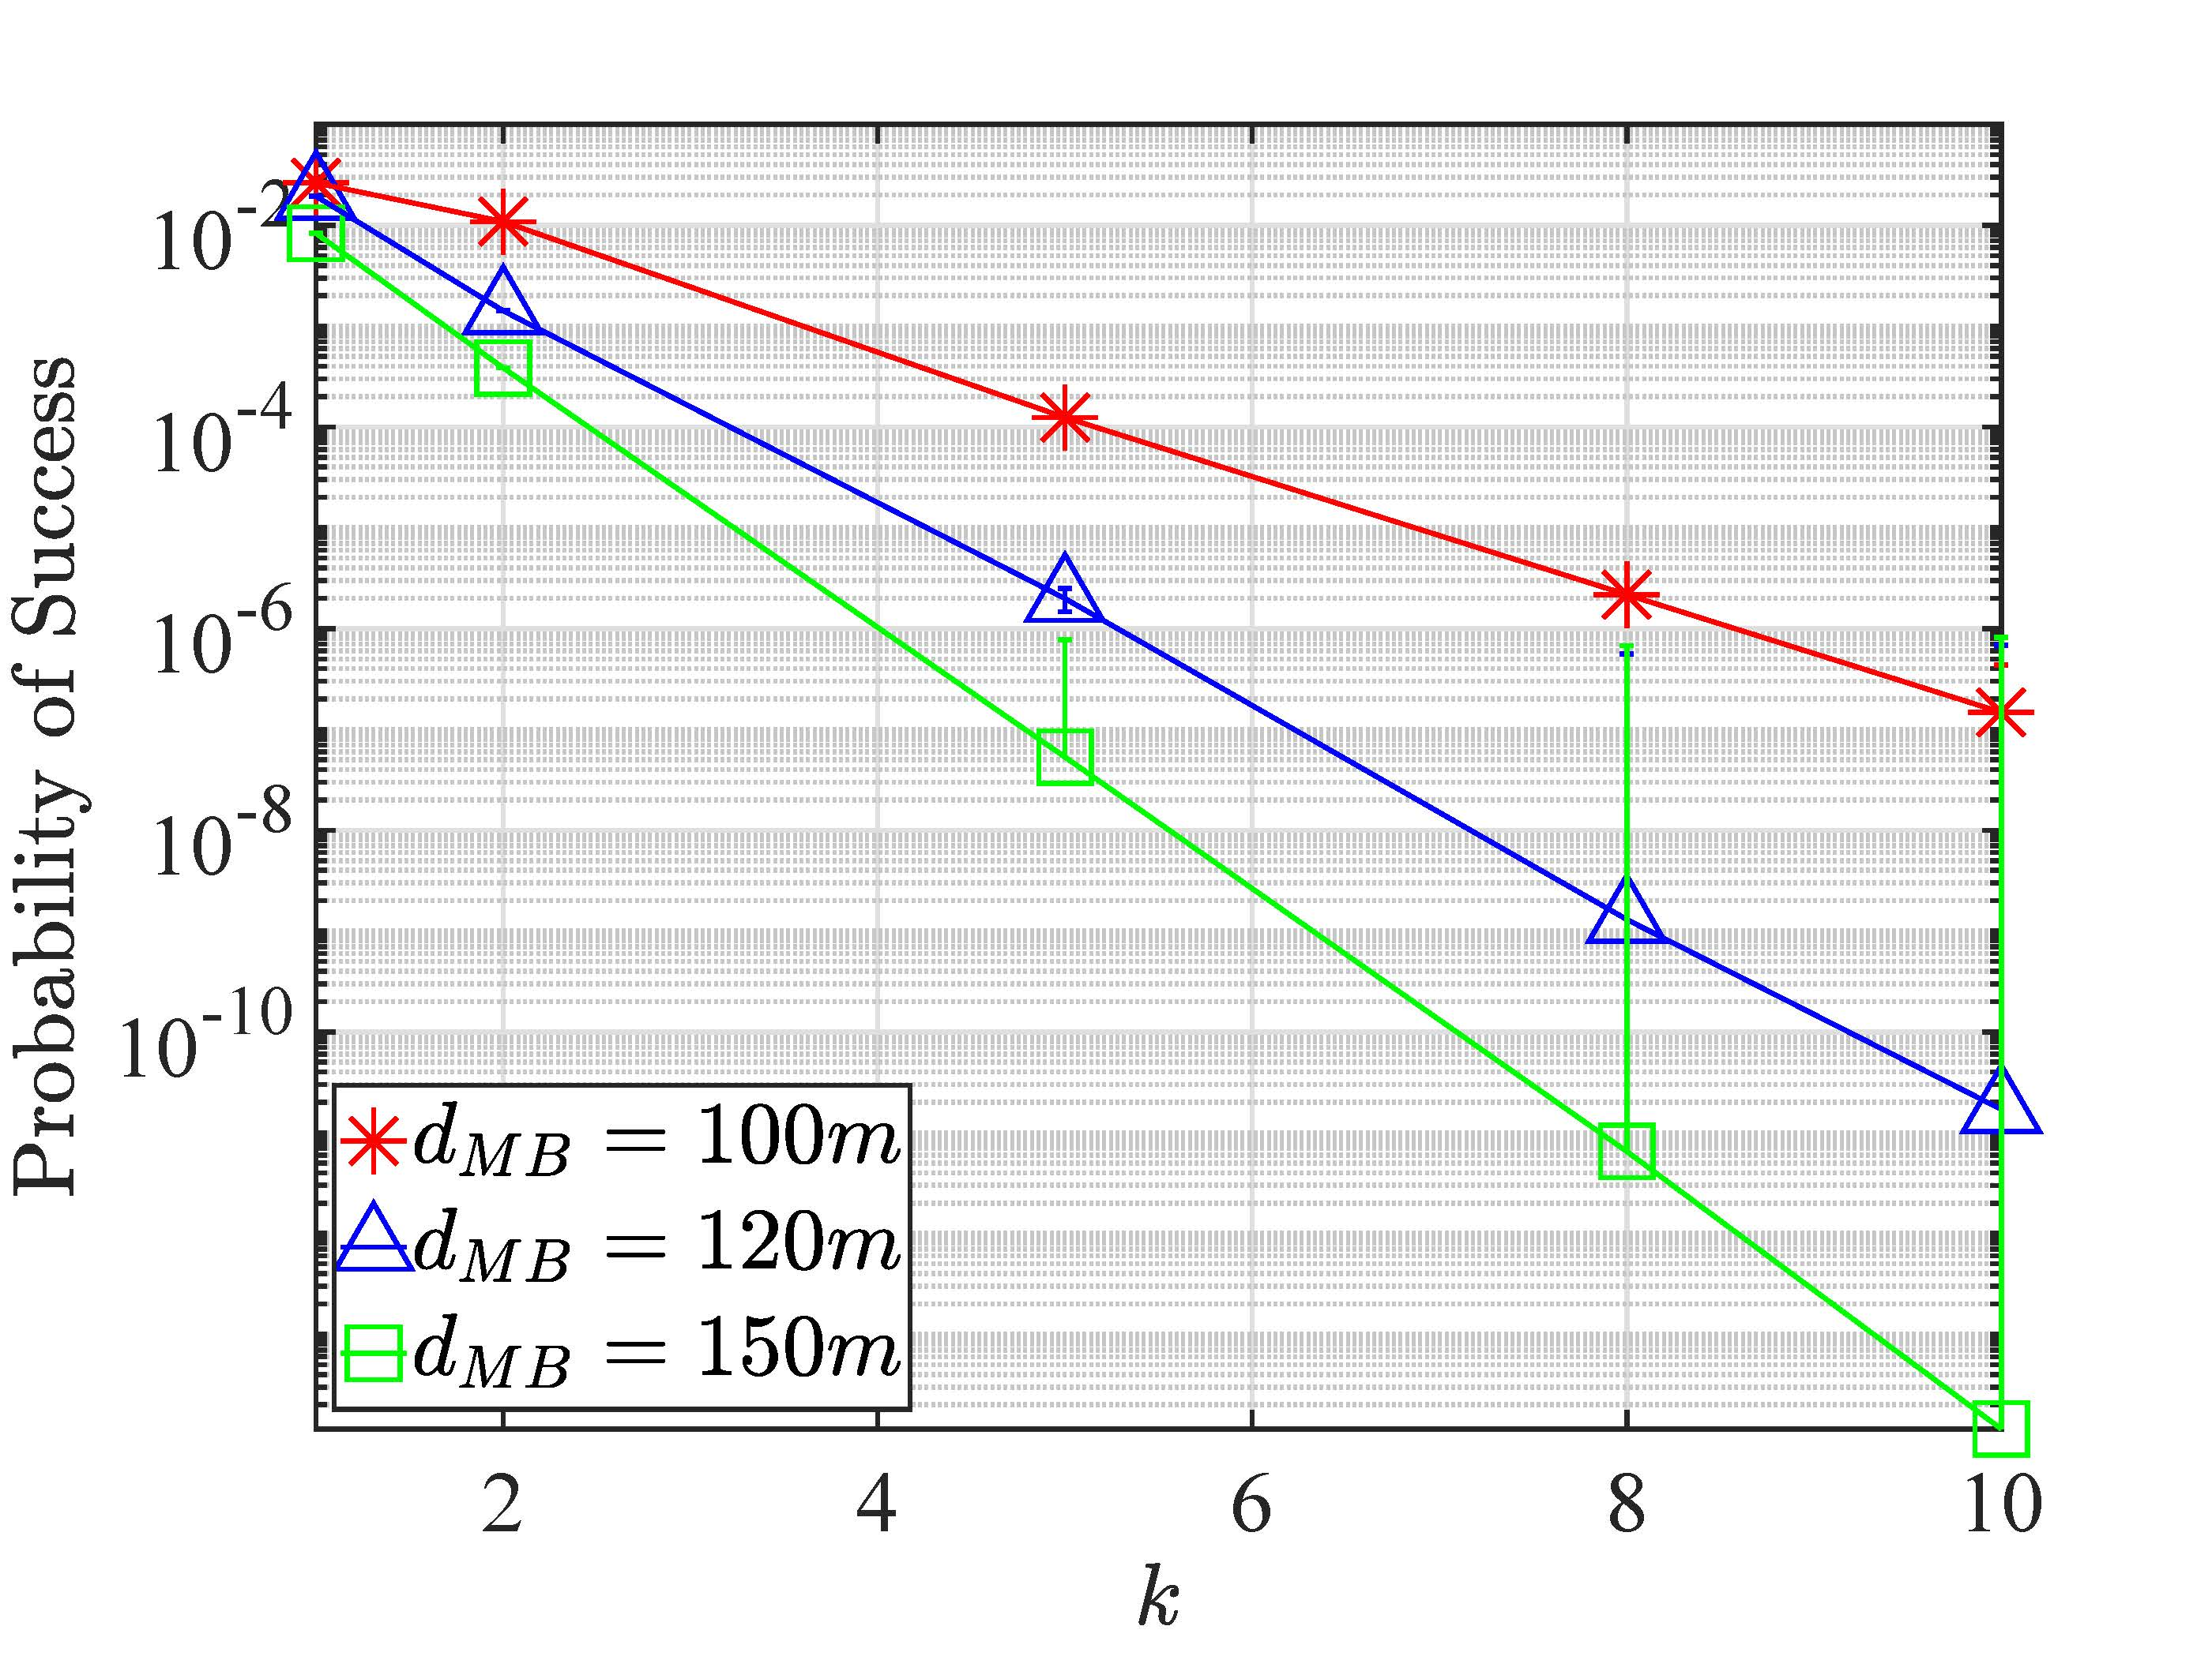
Experimental Evaluation: Robustness Analysis
Very low
Very low
Trajectory
Location
Velocity
The Remote Attacker
VET can detect remote moving adversary attempting to inject rogue messages
As distance increases, the probability of success decreases.

Slide 16
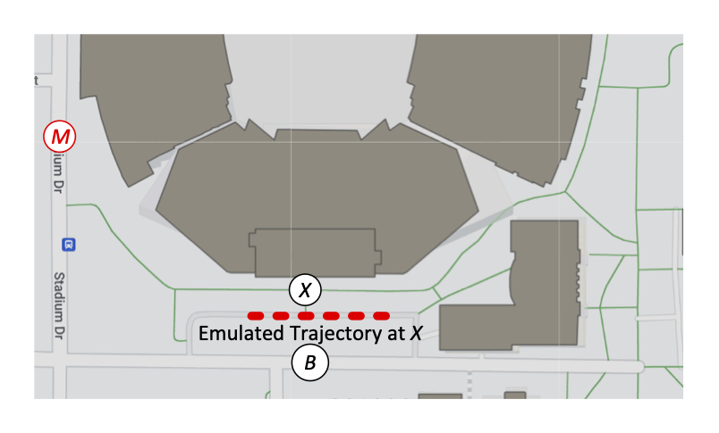
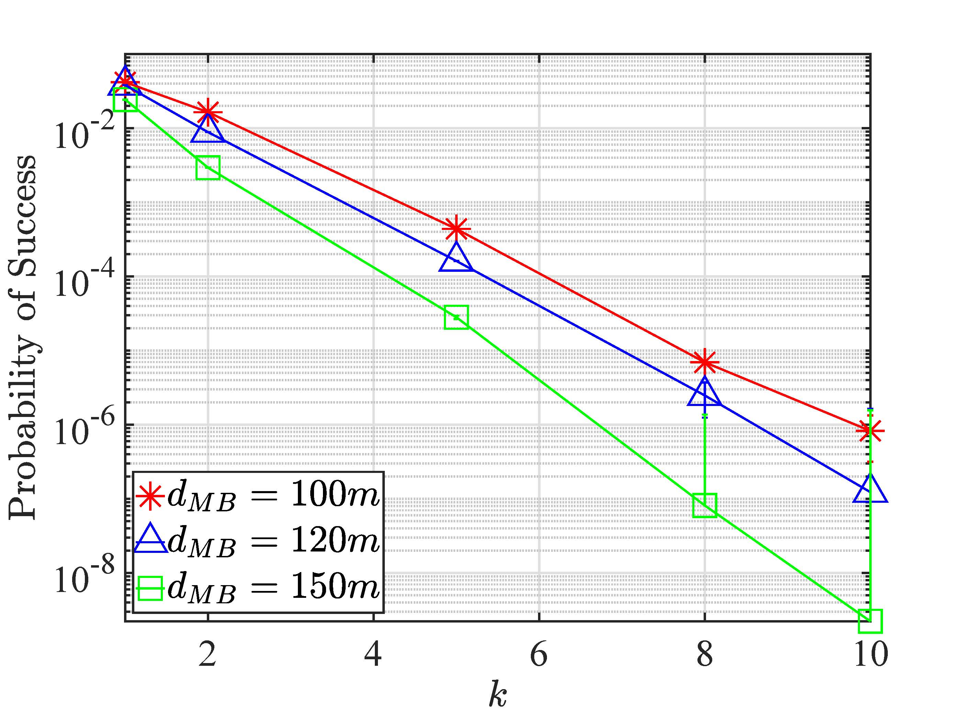
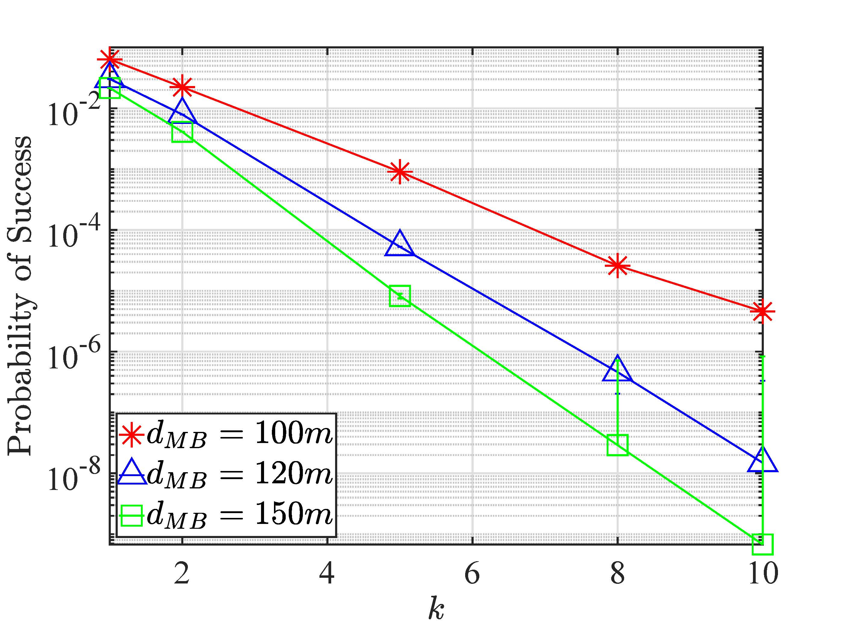
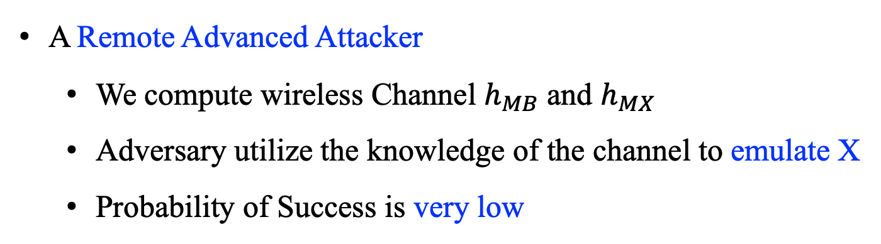
Experimental Evaluation: Robustness Analysis
Very low
Very low
Trajectory
Location
Velocity
A Remote Advanced Attacker
We compute wireless Channel $h_{MB}$ and $h_{MX}$
Adversary utilize the knowledge of the channel to emulate X
Probability of Success is very low

Slide 17
Conclusion and Future Work
We address the problem of secure veracity verification for automomous vehicles
using trajection and motion vectors
We implement a location and motion based strategy that verifies the claimed
TMVs from randomly estimated TMVs
VET can detect remote adversary injecting spoofed messages with 97% true
positives
In the future, we plan to expland our experimental evaluations on UAV platform
with both moving provers and verifiers.
Q&A

